Slide 1

Exploratory Data Analysis on Aspiring Mind Employment Outcome (AMEO)
Vazeer Vinay Kumar

Slide 2



About Me
I'm Vazeer Vinay Kumar, a Computer Science and Engineering graduate from Anurag Group of Institutions in Hyderabad
My journey into the dynamic world of data science began with specialized training at Innomatics Research Labs. I've honed my skills in data science, making it my superpower to uncover patterns and facilitate informed decision-making.
I've actively contributed to the field. I find joy in using data science to navigate complexities and make a positive impact on businesses and organizations. Excited about the rapidly growing field, I am always ready to take on new challenges and contribute to the ever-evolving landscape of data science.
Undergoing specialized training in Data Science and analytics from Innomatics Research labs and I have Experience of 1 Year 2 months in IKS health (US Health care) as an Junior Revenue Cycle Representative.
Linkedin - : www.linkedin.com/in/vinaykumarvazeer
https://github.com/VinayVazeer

Slide 3
Objective of the Project :
Exploring the dataset released by Aspiring Minds from the Aspiring Mind Employment Outcome 2015 (AMEO) to derive insights into the employment landscape for engineering graduates.
Summary of the Project :
Analyze the Aspiring Mind Employment Outcome 2015 (AMEO) dataset, focusing on engineering graduates. Explore employment outcomes (Salary, Job Titles, Job Locations) along with standardized scores in cognitive, technical, and personality skills. The dataset comprises around 40 independent variables and 4000 data points, including demographic features. The goal is to extract insights from this diverse dataset for informed decision-making in the engineering employment domain.

Slide 4
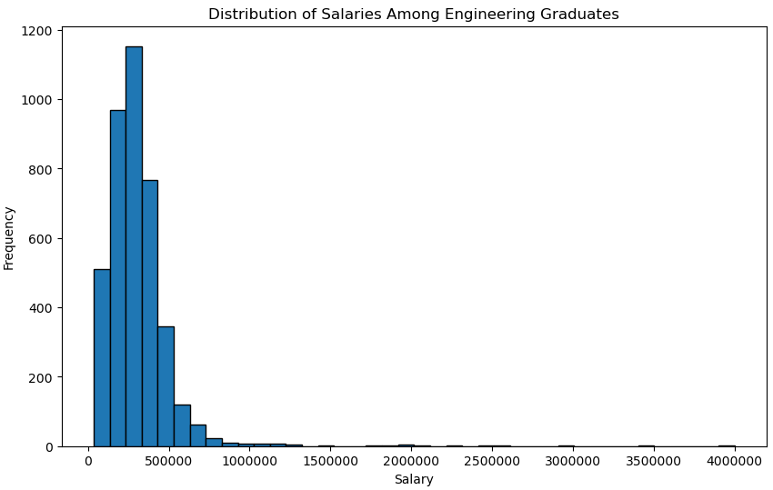
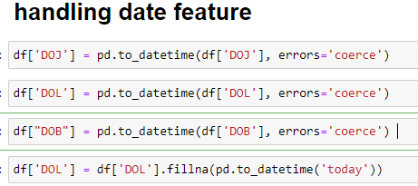
Exploratory Data Analysis
Salary: As per the Histogram we can see that most of the employees salary ranges from 300000-350000/- Annual CTC offered to the candidate (in INR).
Dates: Handled the DOJ (Date of Joining) and DOL (Date of Leaving) columns by converted in date feature method using pandas and also created a “AGE”column The Average age of the employees is around 33 years

Slide 5
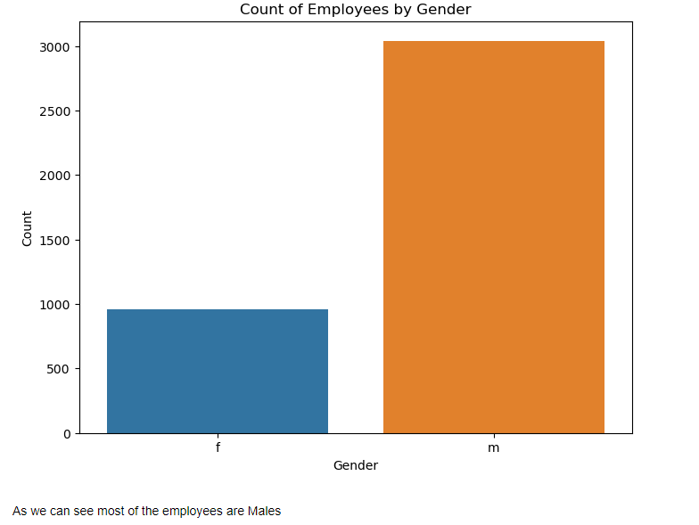
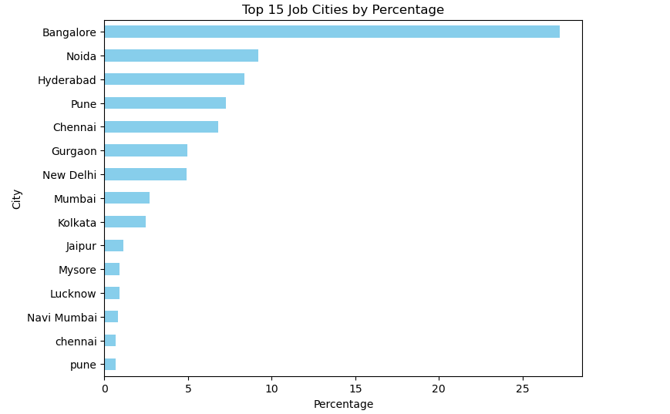
Gender: The count plot tells about the count of employees by Gender so 76% of the Employees are male
JobCity: The Barplot tells abots the Top 15 cities by perncentage and more than 25% percentof the Employees are from bangalore followed by nodia

Slide 6
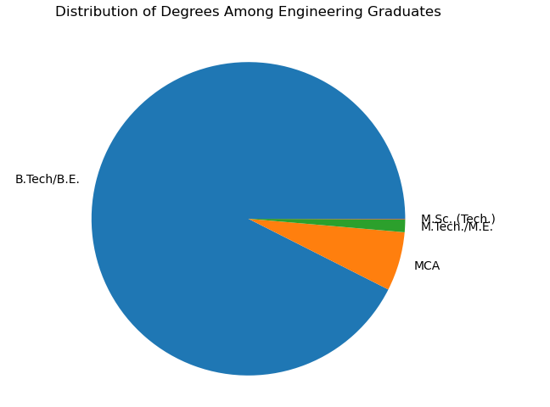
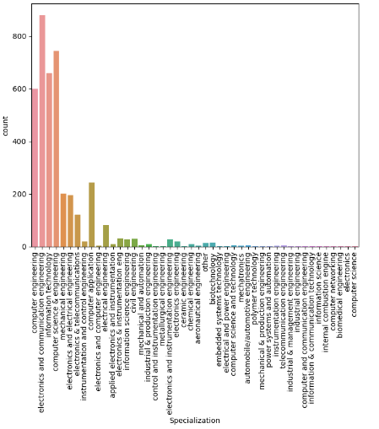
Degree : The Distribution of derees among Graduates 92% of the employees have done their Degree of B.Tech/B.E.
Specialization: We can see that most of the Employees have done their Specialization in Electronics and communication engineering followed by Computer science and engineering and Information technology

Slide 7
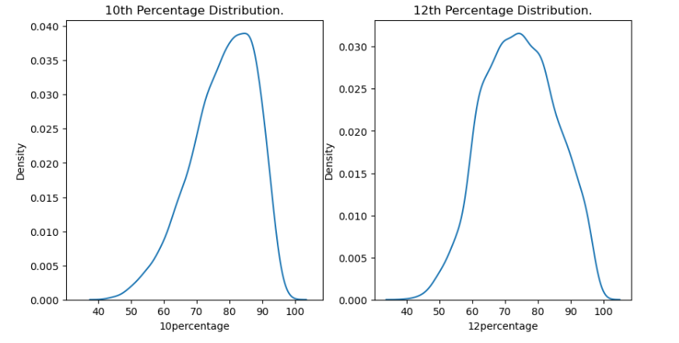
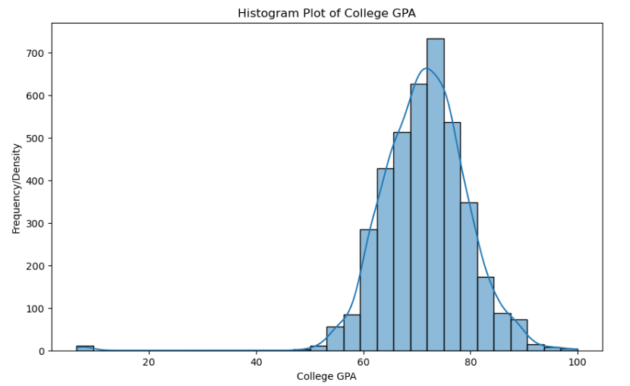
Most of the students achieved a higher percentage in their 12th-grade examinations compared to their 10-grade examinations. as spread is wider in 12th percentage distribution
The histogram of collage GPA tells about most the college GPA's of employees are between 60-80 and we say that its a left skewed normal dist

Slide 8
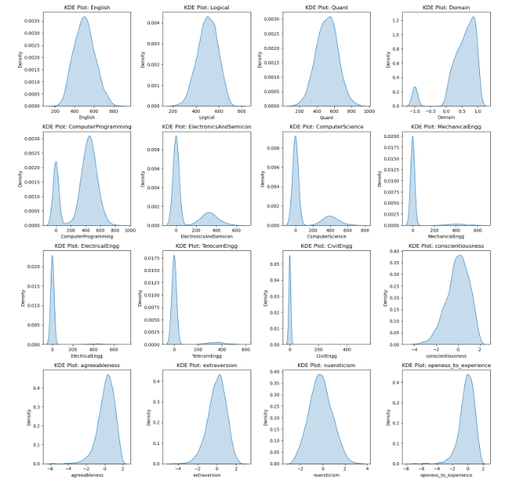


Employees are scores in AMCAT knowledge Subjects and the sections of AMCAT’s personality test
Most of the employees qualified in All test conducted by AMCAT but majority of the employees performed good in 'English', 'Logical', 'Quant', 'Domain', 'ComputerProgramming‘
Clearly females are well performed in Personality tests comapred to men

Slide 9
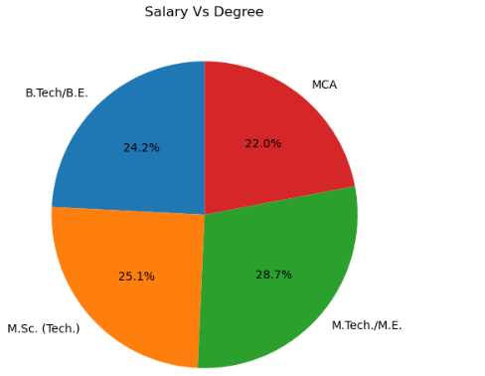
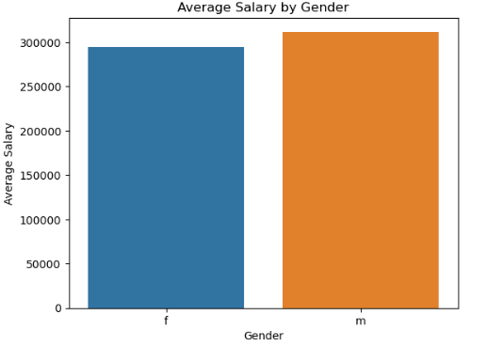
Salary Vs Degree:
Employees who have done their M.Tech/M.E having highest avg paying salaries followed by M.Sc. (Tech.) compared to other Degrees
Gender vs Salary:
The barplot tells about that Males are Earning more with an avg of more than 300000/-

Slide 10
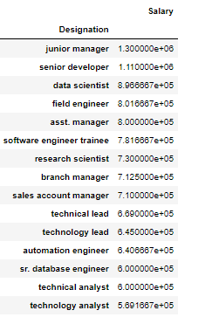
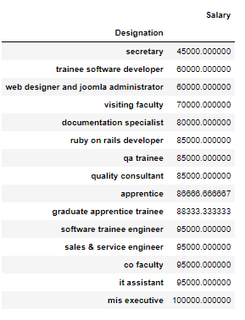
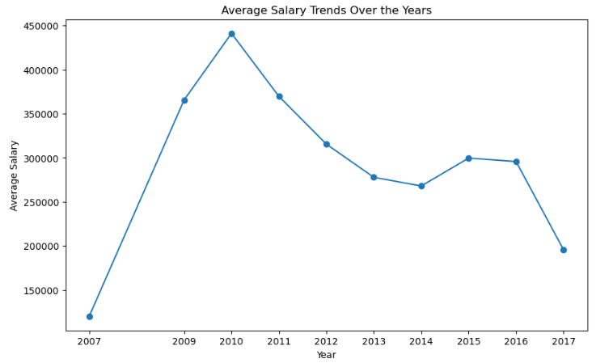
Salary Vs Designation:
The Designation of Junior Manager is having the Highest Paying Salary followed by Senior Development compared to other designations
The Designation of secretary is having the least Paying Salary followed by trainee software developer compared to other designations
Salary Vs GraduationYear
2010 Graduates Passed out are having with Highest avg paying Salaries above 420000/-

Slide 11
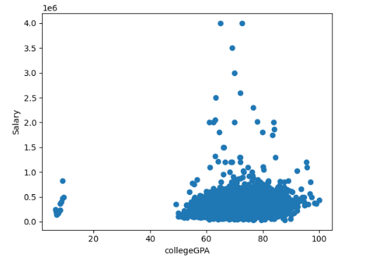
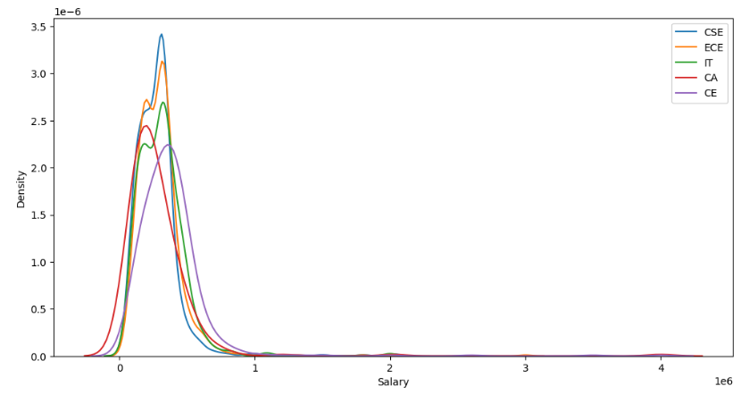
Salary Vs Collage GPA:
Employees who scored b/w 60-80 having almost having salaries ranged from 500000-1500000
Salary Vs Specialization:
Most of the Employees have chooses the CSE,ECE,IT,CA,CE Specializations and their Salary distributions so we can say that who have specialized in computer science & engineering having highest paying jobs followed by electronics and communication engineering ,information technology

Slide 12
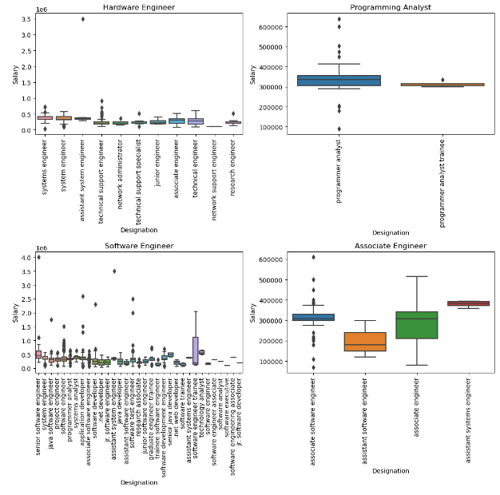
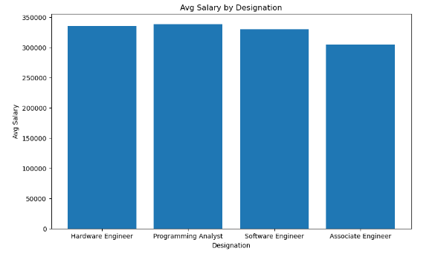
Research Questions

Slide 13
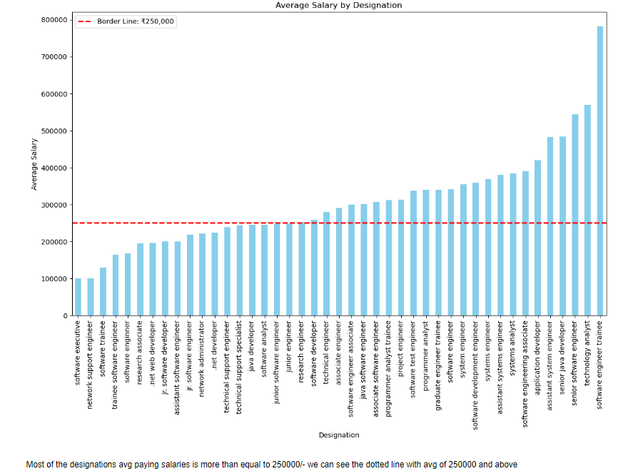
Programming Analyst is having highest avg salary by designation compared to Software Engineer, Hardware engineer and Associate engineer with avg salary of 300000/- above but there is no much difference in average salaries by designations and performed Annova test found that There is no significant difference in average salaries.
After doing your Computer Science Engineering if you take up jobs as a Programming Analyst, Software Engineer, Hardware Engineer and Associate Engineer you can earn up to 2.5-3 lakhs as a fresh graduate.

Slide 14
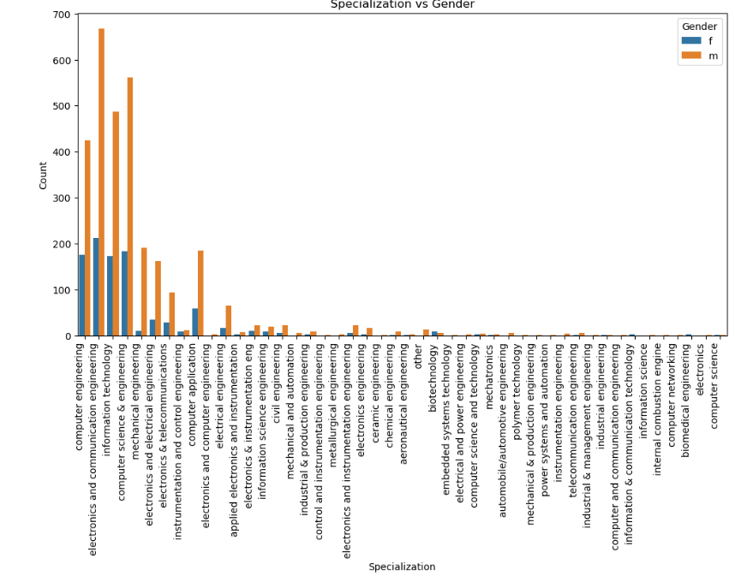
A Chi-Square test, a statistical method for examining the association between categorical variables, was conducted on the variables of Gender and Specialization. The test revealed a statistically a 95% of significant relationship between a candidate's gender and their chosen specialization.

Slide 15
Conclusion
The AMEO dataset provides a view of employment outcomes for engineering graduates. Key findings include average salary and age trends, gender distribution, academic achievements, and the impact of specialization and designations on salaries. The dataset's insights offer valuable guidance for career planning, and understanding of the engineering job market. The statistically significant relationship between gender and specialization underscores the importance of considering demographic factors in career choices. Overall, the AMEO dataset serves as a valuable resource for informed decision-making in the dynamic landscape of engineering employment.

Slide 16

THANK YOU

